Slide 1
ECLIPSE CHECKSTYLE PLUGIN
LINH CHAU

Slide 2

Agenda
Introduction
Installation
Custom configuration
Advance configuration

Slide 3
Introduction
Is a Open Source development tool.
Helps to ensure that Java code adheres to a set of coding standards.
Integrates the static source code analyzer into Eclipse IDE.
Notifies problem immediately.

Slide 4
Installation
Via Eclipse Marketplace link (recommended).
Via Eclipse Marketplace client.
From the update site.
Reference link:
Eclipse-sc Installation
Project Setup

Slide 5
Custom Configuration
Open Preferences windows → select Checkstyle.
Instruction: Custom Configuration

Slide 6
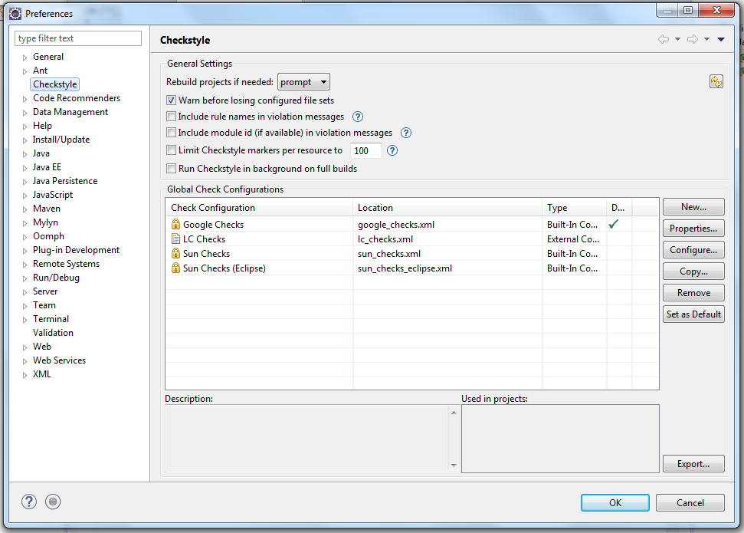

Slide 7
Advance Configuration
Restrict Checkstyle validation using project filters
Configuration types
Configuring file sets

Slide 8
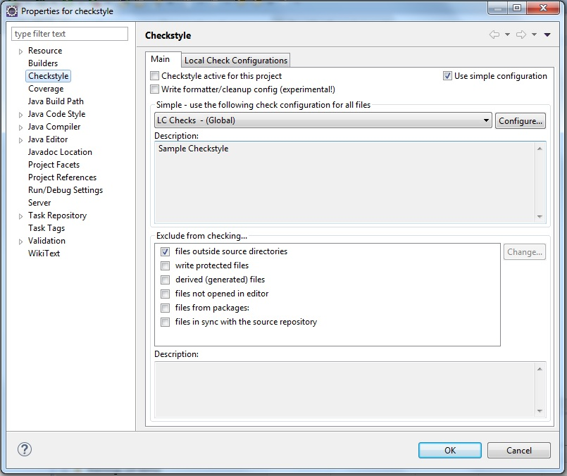
Project filters
Notes:
http://eclipse-cs.sourceforge.net/#!/filters

Slide 9
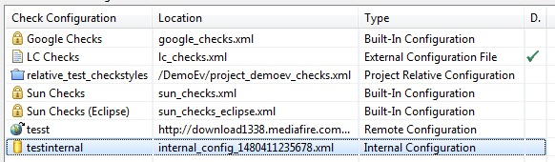
Configuration types
Built-in Configuration
Internal Configuration
External Configuration
Remote Configuration
Project Relative Configuration
Notes:
http://eclipse-cs.sourceforge.net/#!/configtypes
Link for remote demo: http://download1338.mediafire.com/b4nt5rz4p0rg/qhgr8pz0hfjnb17/test_remote_checks.xml

Slide 10
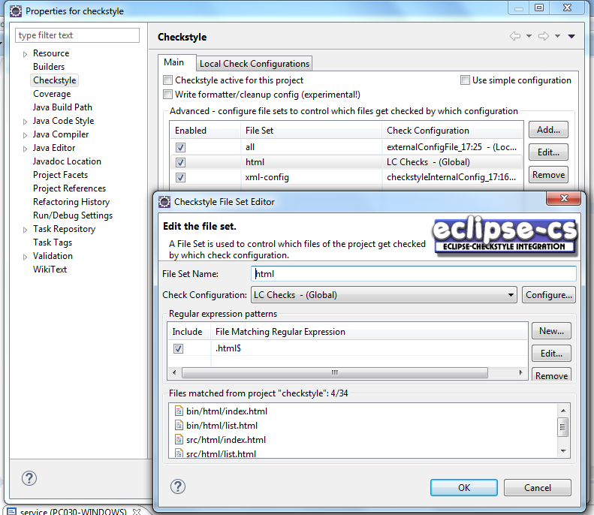
Configuring file sets
Notes:
http://eclipse-cs.sourceforge.net/#!/filesets

Slide 11
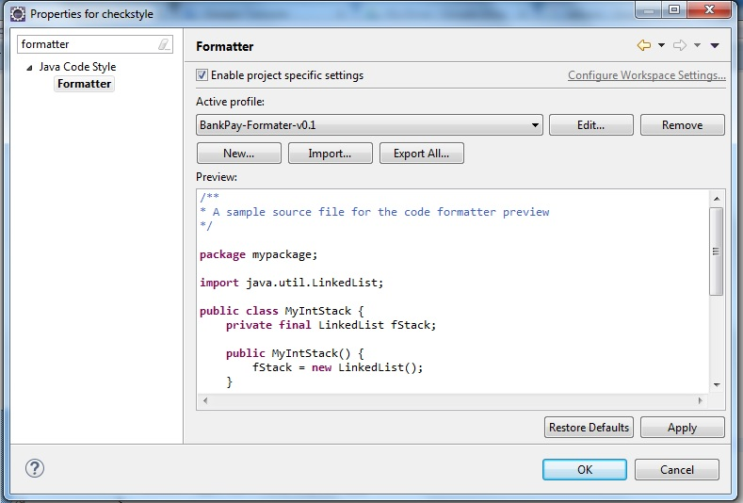
Bonus: Eclipse formatter

Slide 12
Q&A

Slide 13


